Slide 1


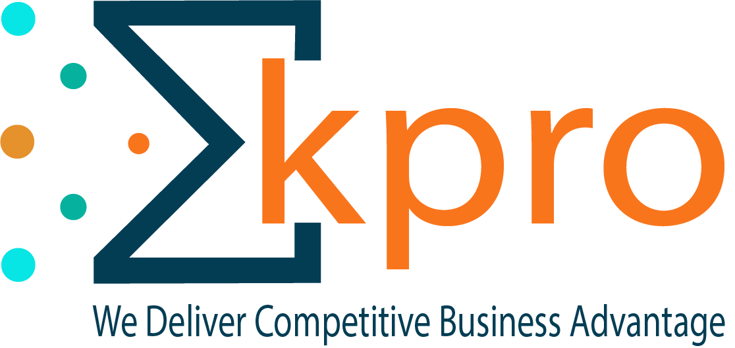
Kpro Solutions Pvt. Ltd.
www.kproai.com

Slide 2
  Agenda
About Kpro
Our Clients
Our Team
    Our Products

Slide 3
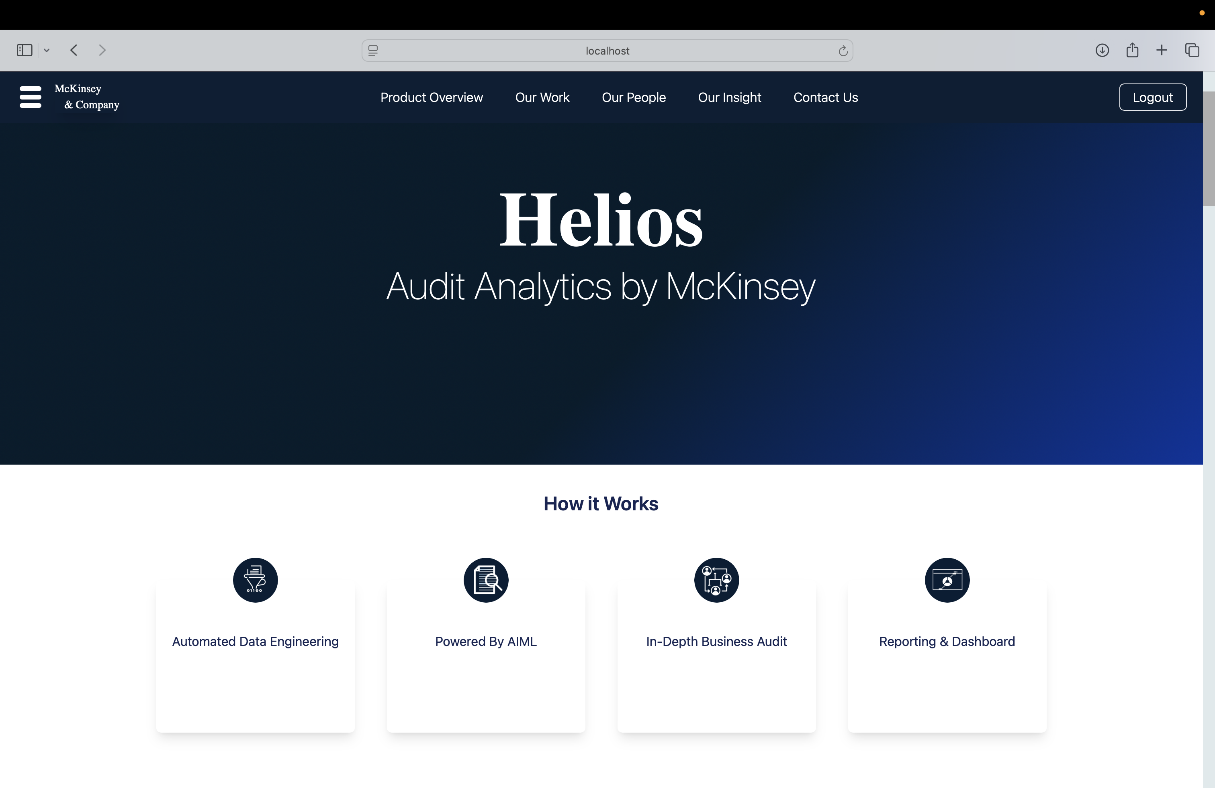
Kpro Introduction
USP
About Kpro
1
Business Outcome Driven Approach
1
Kpro Mantra
  Started in 2014
2
Fixed Cost Models to Minimize
the Implementation Risk
Speed
Adaptability
2
  Highly Skilled Professionals
Quality
3
Fast Realization of Values
using Acceleration Framework
3
  Data Lake, BigData, Blockchain, IOT, Cloud, Analytics
Fixed Cost Models to Minimize the Implementation Risk
Consulting to Product Mindset
4
Fixed Cost Models to Minimize the Implementation Risk
Multi Domain Expertise
4
  Data Science(ML, AI), Mobile
  Apps, Custom Applications
Fast Realization of Values
Using Acceleration Framework

Slide 4











  Our Clients
Part level
Forecasting and Safety Stock
End to end Supply Chain Analytics for Daimler Fuso
End Customer Segmentation and Customer Experience
Real time Road Side
Assistance Mobile App
AI enabled Audit Product Development
Analytics on Real time
Transaction for Fraud and Anomaly Detection
Churn Analytics
and Inactive Customer Activation
Customer
Behavior Analytics
and Recommendations
Asansol Municipal Corporation
Security Implementation
Application CR Management & Decommissioning of Tool
Complete Platform and CRM Applications
Complete CRM and ERP Solutions

Slide 5
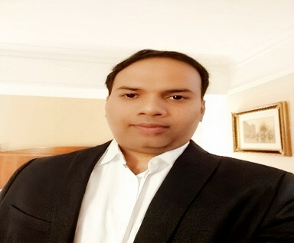
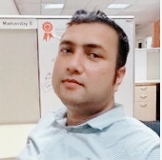
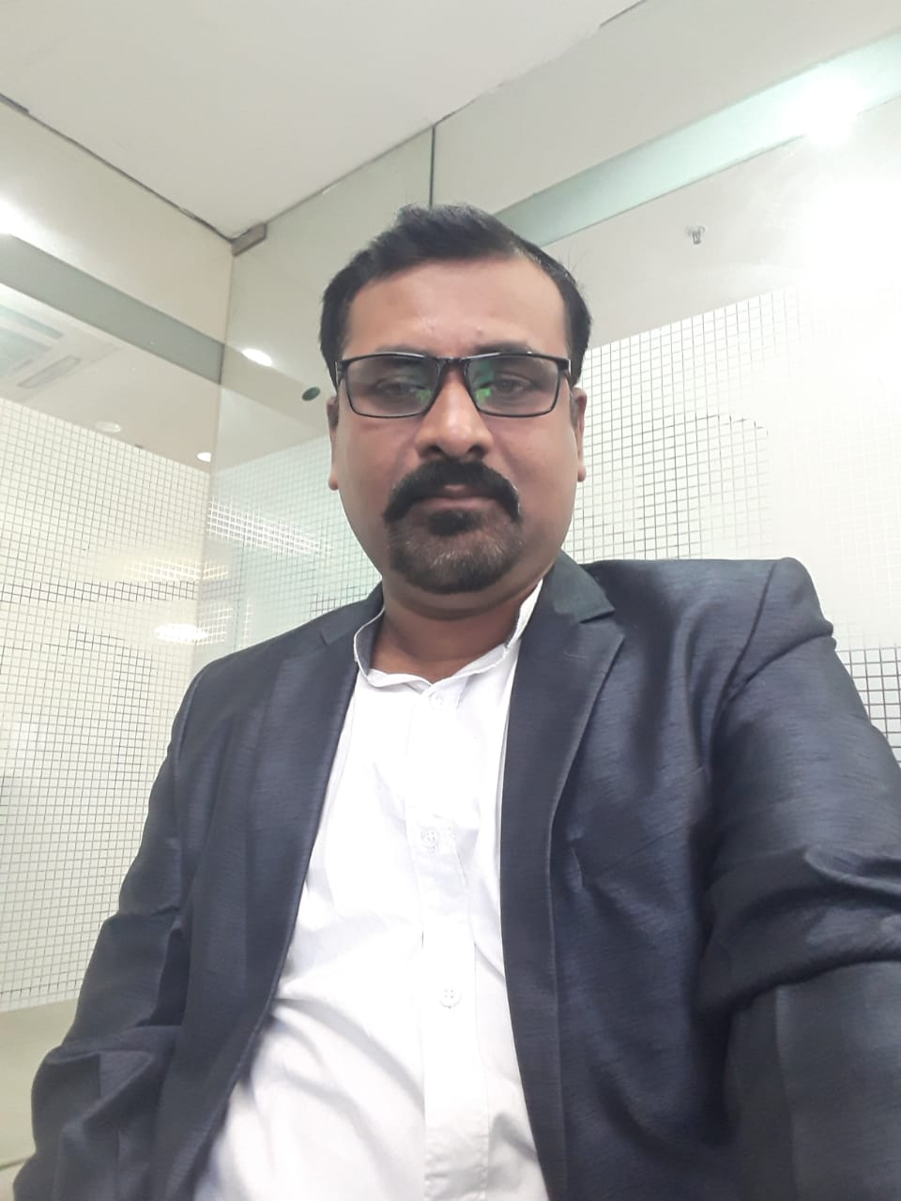
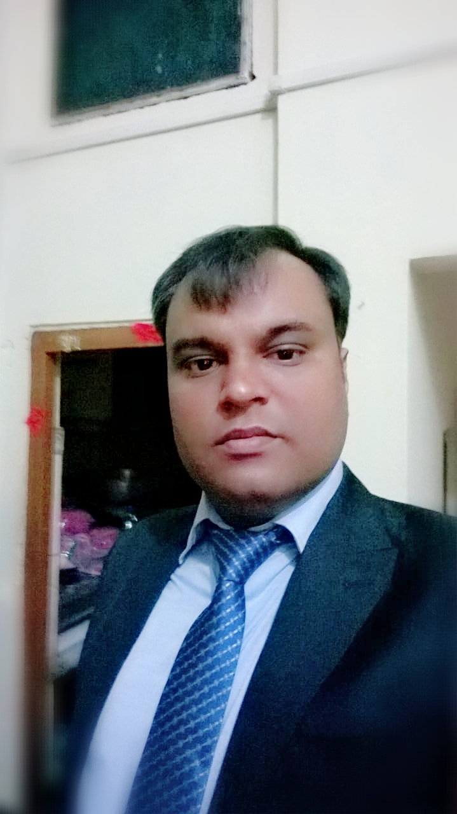
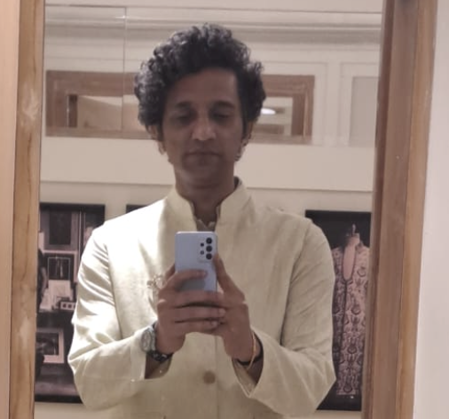
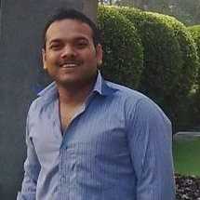
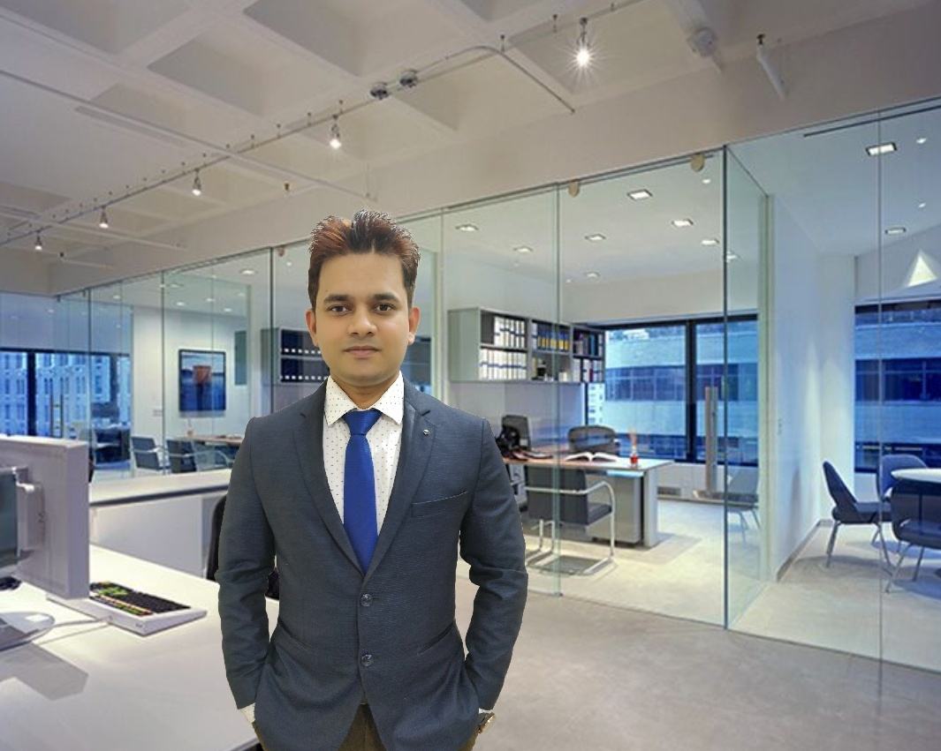
Core Leadership Team
Markanday
Shukla
24+ Years of experience
(DBS, Teradata, Mercedez, Avaya, Aegis)
20+ Years of experience
(McKinsey, Fiserv, Zafin, TataSky, Aegis)
Alok Ranjan
15+ years of experience
(FIS, Rackspace ,Oracle, IBM, Flex )
Rupak Sriwastwa
Neeraj Tiwari
20+ years of experience
(Infosys, Accenture, Kpro)
Bharath Shetty
Pankaj Pandey
20+ Years of experience
(McKinsey, HP, Microsoft, Dell, Aegis)
15+ Years of experience
(McKinsey, Zafin, IBM, TataSky )

Slide 6




  Assets
Products
Nyota (Making event an experience)
Forensic Audit (Saving money for organization)
BuildMyCV
(Platform to create resume)
Customer Engagement Scoring Framework
Customer Experience Analytics
Frameworks
1. Acceleration Framework 2. Design Templates 3. Review Templates
Services
1. Consulting 2. Machine Learning and Artificial Intelligence 3. Custom Use Cases 4.Business Intelligence Applications 5. Mobile Application 6. Security Services 7. IOT/Blockchain 8. Managed Services 9. Training 10. Staff Augmentation
Processes
1. Hiring & On-Boarding Process (Bootcamp) 2. Training & Development 3. Gang Model of execution
Human Resources
1. Highly skilled Engineers 2. Data Scientists and Architects.
Current Employee Strength is 47 (Including 21 Trainees)

Slide 7
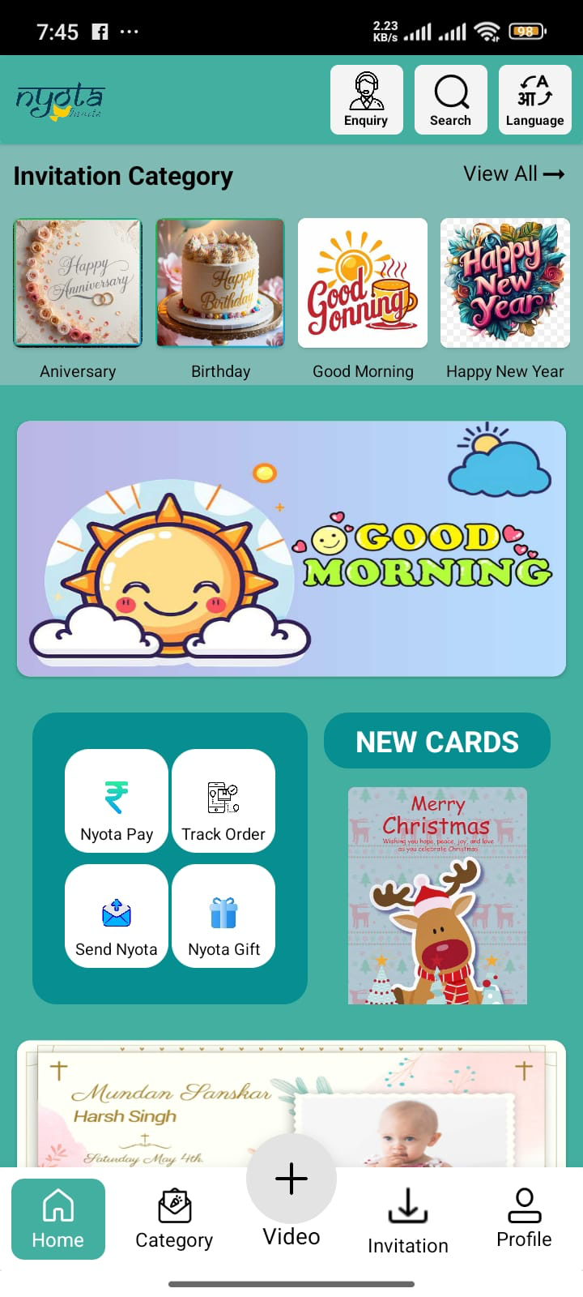
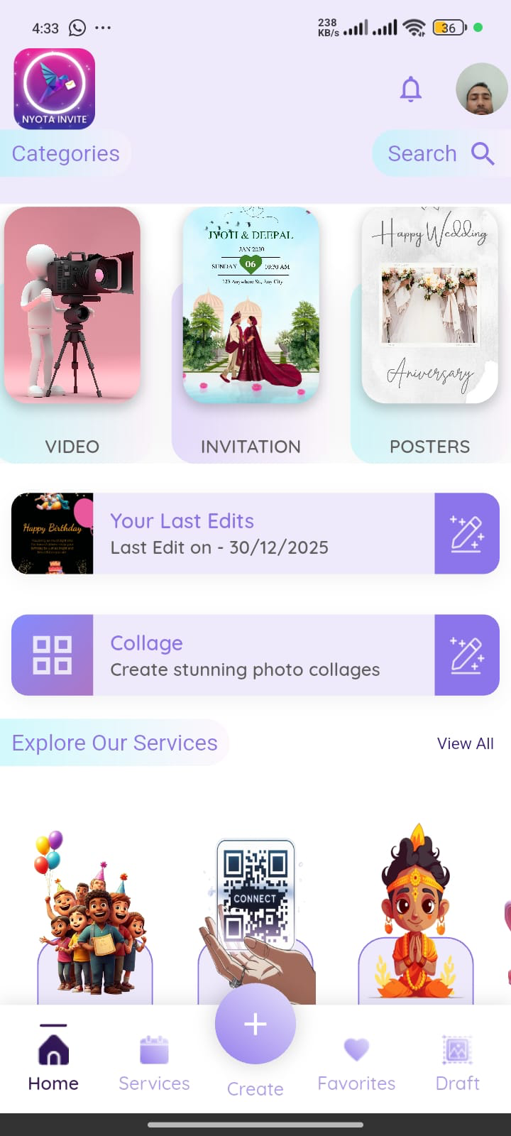
  Nyota Invite
How to make money
Strategy to Monetization
Freemium Model
In-App Purchases (IAP)
Event and Party Planning Partnerships
Corporate/Group Sales
Subscription Model
Custom Invitation Services
Vendor and Suppliers (11% Commission)
Download the app now and start
🍎 Apple: https://lnkd.in/ggPKKHQU
🤖 Android: https://lnkd.in/ggdyvE9w
Nyota V1.0
Nyota V2.0

Slide 8



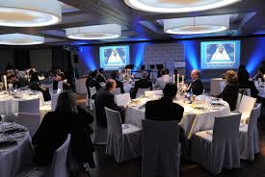
  Nyota – Product Detail
2
3
Family Parties
4
5
6
1
Opt. all required services
Pay to Nyota
Feedback and Fulfillment
Friends Parties
Political Parties
Create Digital Invitation, Posters, Videos
Manage details of event, inviter, invitees, Vendors and suppliers
Organize end to end events
Create memorable events through photo and videos
Maintain all expenses related with any events
Organize gifting process
Misc.
Corporate Parties

Slide 9
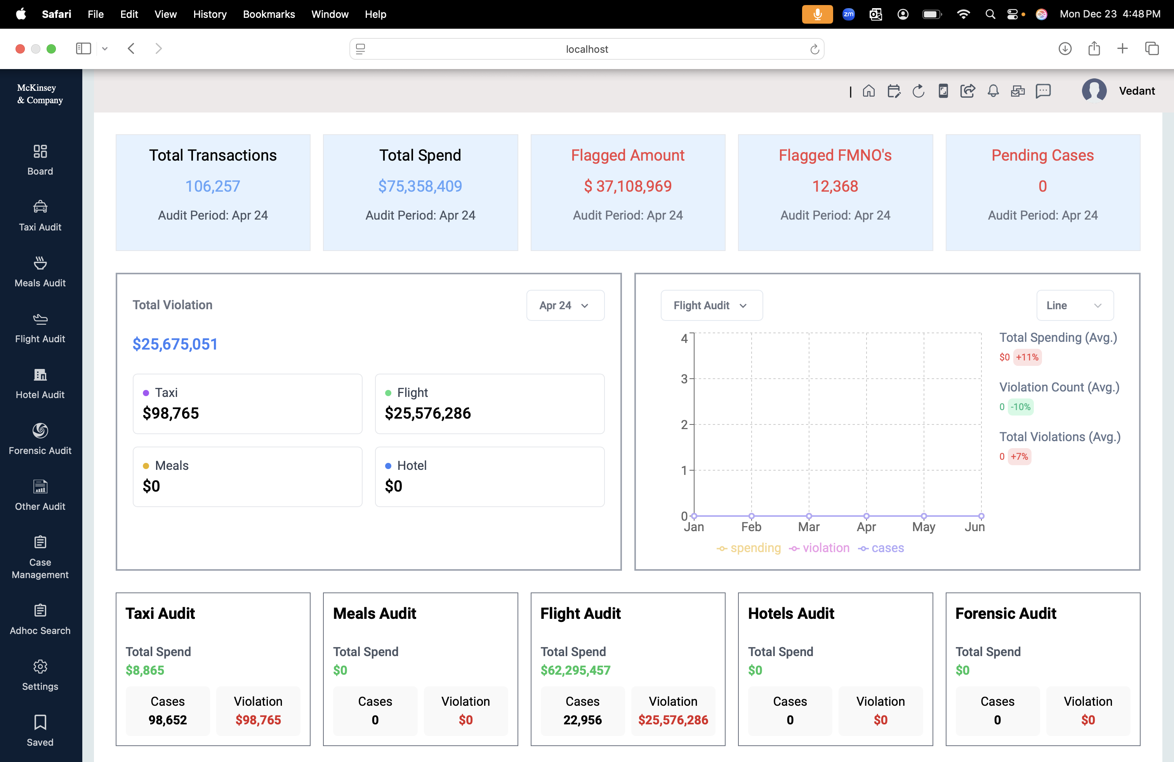
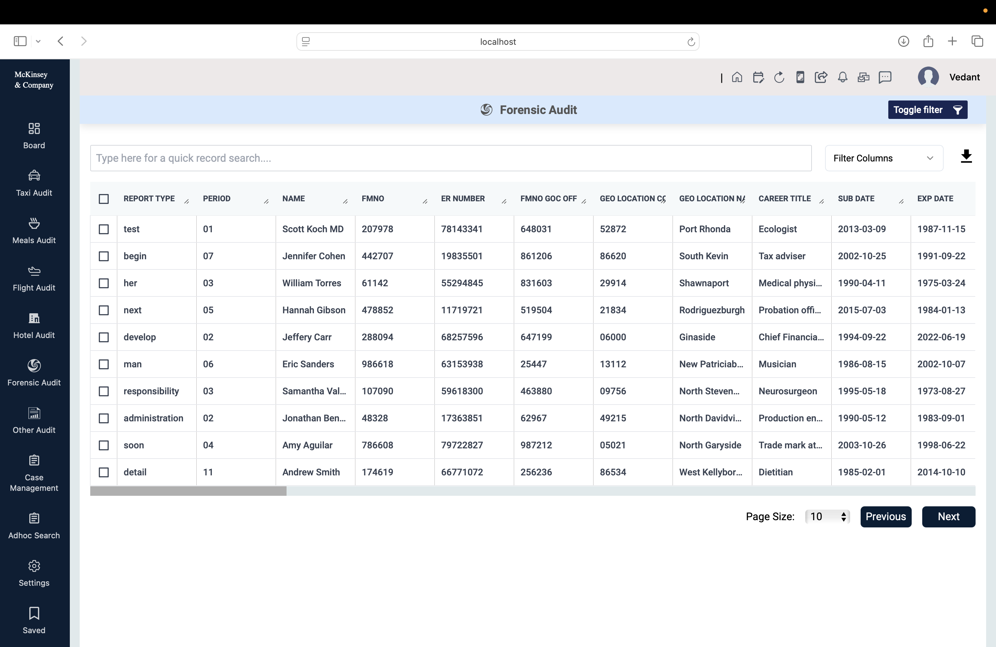
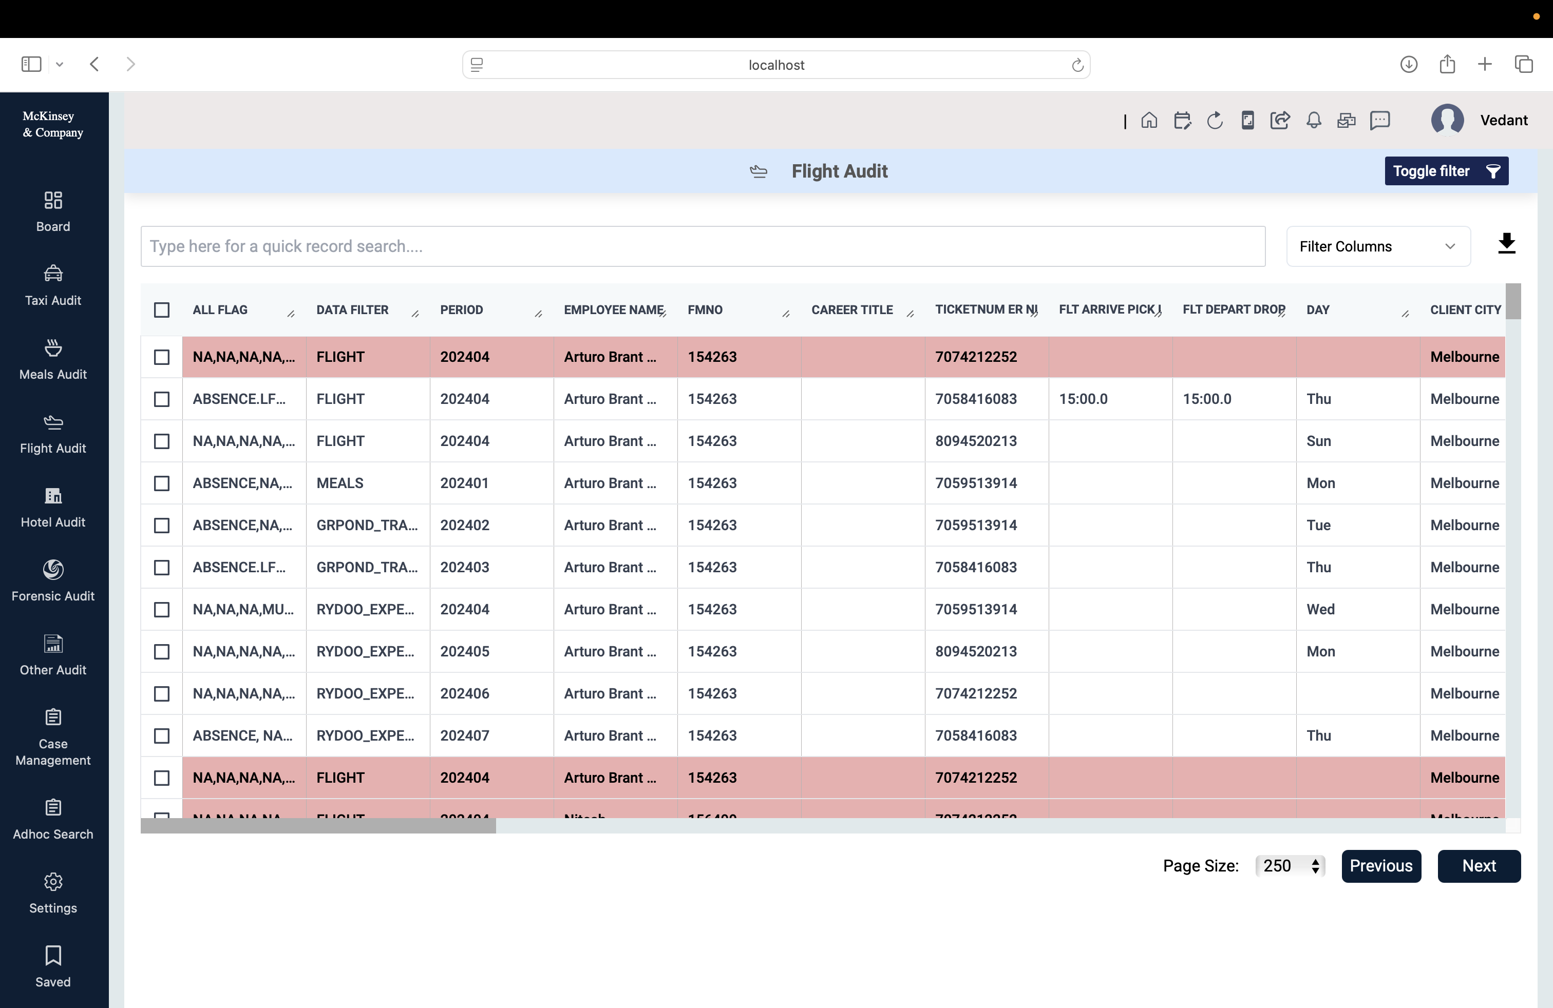
  Expense Submission and Audit - ExpAudit
Monetization Model | Revenue Type
Freemium Model | Subscription (Monthly/Annual)
Transaction Fees | Per-Transaction Fees
Corporate/Enterprise Sales | Licensing, Subscription, Per-User Fees
Affiliate Marketing | Commissions from Affiliates
Data Insights | Data Sales
Premium Features/Add-ons | One-Time Payments, Subscriptions
Travel Insurance Partnerships | Commissions from Insurance Sales
White-Label Solution | Licensing Fees
API Access | API Access Fees

Slide 10
  Expense Submission and Audit - ExpAudit
Monetization Model | Revenue Type
B2B | Subscription (Monthly/Annual)
Transaction Fees | Per-Transaction Fees
Corporate/Enterprise Sales | Licensing, Subscription, Per-User Fees

Slide 11
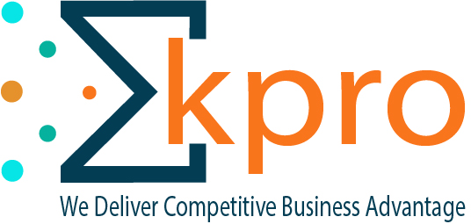
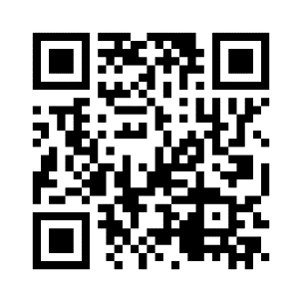
Thank You!!
www.kpro.co.in

Slide 12




Our Open Source Contribution & Co-ordinates
https://www.youtube.com/channel/UCcks4KEpT694r1Qj2gwTqyQ/featured?reload=9&disable_polymer=true
https://www.facebook.com/kpro.solutions.pvt
https://www.linkedin.com/company/kprosolutions
https://twitter.com/kprosolutions

Slide 13
  Exit Strategy for Seed Investor
Series B Funding
Acquisition by a Larger Company
Investors sell their shares to other investors or private equity firms.
The startup offers to buy back shares from the seed investors at a predefined valuation.
Investors’ equity can be converted into debt instruments, providing periodic returns.
Timeline: 6 Years
Best Case: 2.5 times of invested money (~16.5% XIRR per annum - 8,10,11,546 + 10% Company Equity)
Average Case: 1.6 times of invested money (~12.5% XIRR per annum - 5,81,84,303 + 7% Company Equity)
Worst Case: Invested money + FD Return (9% Yearly - 4,56,73,229 + 5% Company Equity)
Kpro Revenue
 | Revenue in Rupees |  |  | Investment/ Expenses Required |  |  | Break Even Projection |  |  | Funding Startegy Roadmap
Year | Best Case | Average Case | Worst Case | Best Case | Average Case | Worst Case | Best Case | Average Case | Worst Case
2025 | 3200000 | 1600000 | 20000 | 25000000 | 25000000 | 25000000 | -21800000 | -23400000 | -24980000 | Seed Funding 3 to 4 CR
2026 | 7000000 | 3200000 | 1600000 | 17500000 | 17500000 | 12500000 | -10500000 | -14300000 | -10900000
2027 | 13000000 | 5500000 | 3400000 | 37500000 | 27500000 | 12500000 | -24500000 | -22000000 | -9100000 | Series A Funding 1 to 1.5 Million Dollar
2028 | 20000000 | 9500000 | 5300000 | 55000000 | 32500000 | 17500000 | -35000000 | -23000000 | -12200000
2029 | 34000000 | 14500000 | 9100000 | 75000000 | 42500000 | 17500000 | -41000000 | -28000000 | -8400000
2030 | 54500000 | 21500000 | 13700000 | 75000000 | 52500000 | 17500000 | -20500000 | -31000000 | -3800000 | Series B Funding 2 to 2.5 Million Dollar *
2031 | 94000000 | 35500000 | 21400000 | 87500000 | 75000000 | 30000000 | 6500000 | -39500000 | -8600000
2032 | 229500000 | 72000000 | 38700000 | 97500000 | 87500000 | 45000000 | 132000000 | -15500000 | -6300000
2033 | 621000000 | 174000000 | 81600000 | 107500000 | 87500000 | 47500000 | 513500000 | 86500000 | 34100000
2034 | 2356500000 | 612000000 | 260400000 | 127500000 | 87500000 | 57500000 | 2229000000 | 524500000 | 202900000
Total | 3432700000 | 949300000 | 435220000 | 705000000 | 535000000 | 282500000 | 2727700000 | 414300000 | 152720000
ARPU- 200 Rs per user per year
* Exit offer based on choice at series B funding
Bonus- Depends on funding or
Notes:
Description:
Description: Transitioning from a private to a public company through an IPO allows investors to sell their shares on the open market.
Strategy: Set milestones to reach the public market readiness, focusing on scalability and profitability to attract public investors.
Secondary Sale

Slide 14
  Expense and Audit – Product Detail
2
3
4
5
1
Plan Trip
Get Approval
Manage Trip
Submit Expense
Approve Expense
Pay Expenses
Perform Audit
Expense capture: Capture expenses, mileage, and per diem using the app
Receipt scanner: Use the AI-powered receipt scanner to submit expenses quickly
Automated approvals: Set custom policy rules to automate expense approvals
Mileage tracking: Submit and process compliant mileage entries
Credit card reconciliation: Automate the credit card reconciliation process
Smart Audit: Use AI to automatically detect and flag non-compliant and suspicious claims
Real-time visibility: Finance teams have real-time visibility on employee spend
Currency conversion: App converts foreign currency using real-time exchange rates
Expense cards: Smart virtual and physical business cards for one-time and recurring spending
Notes:
Description:
Description: Transitioning from a private to a public company through an IPO allows investors to sell their shares on the open market.
Strategy: Set milestones to reach the public market readiness, focusing on scalability and profitability to attract public investors.
Secondary Sale

Slide 15
  Exit Strategy
Step 1: Bootstrapping
Objective: Prove the concept with minimal resources.
Action: Develop a minimum viable product (MVP) and gain initial traction.
Step 2: Pre-Seed Funding
Objective: Validate the idea with a basic prototype or proof of concept.
Action: Build a core team and refine the business model.
Step 3: Seed Funding
Objective: Develop the product further, conduct market research, and acquire early customers.
Action: Create a compelling pitch deck, demonstrate product-market fit, and start reaching out to investors.
Step 4: Pre Series A Funding
Objective: Expand the team, enhance product features, and grow the customer base.
Action: Show consistent revenue growth, provide metrics that prove sustainability, and seek investors interested in
scaling ventures.
Step 5: Series B Funding
Objective: Further scale operations, penetrate new markets, and improve infrastructure.
Action: Demonstrate business scalability, strong financial performance, and strategic growth plans.
Step 6: Series C and Beyond
Objective: Prepare for potential IPO or acquisition, enter international markets, and enhance competitive positioning.
Action: Show robust growth metrics, a solid market position, and strong operational foundations.
Step 7: Initial Public Offering (IPO) or Acquisition
IPO Definition: The process of a private company offering shares to the public in a new stock issuance.
Acquisition Definition: Being bought out by a larger company.
Notes:
Description:
Description: Transitioning from a private to a public company through an IPO allows investors to sell their shares on the open market.
Strategy: Set milestones to reach the public market readiness, focusing on scalability and profitability to attract public investors.
Secondary Sale

Slide 16
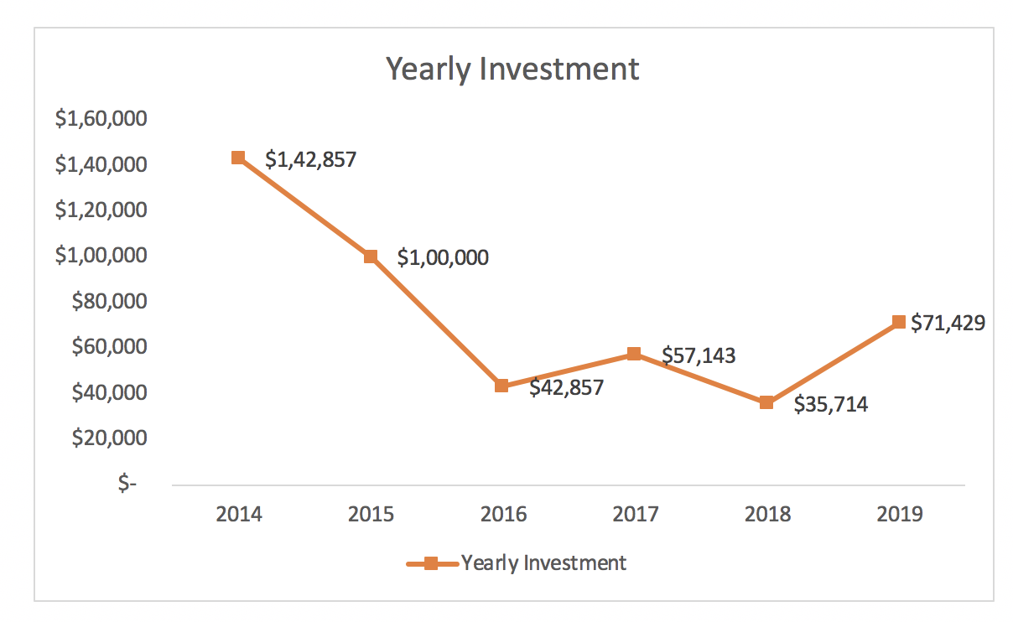
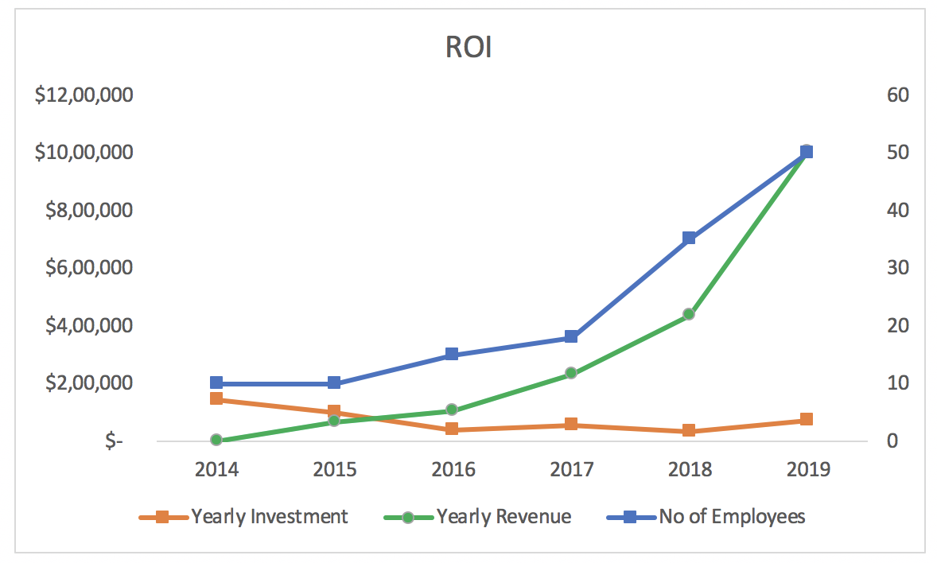
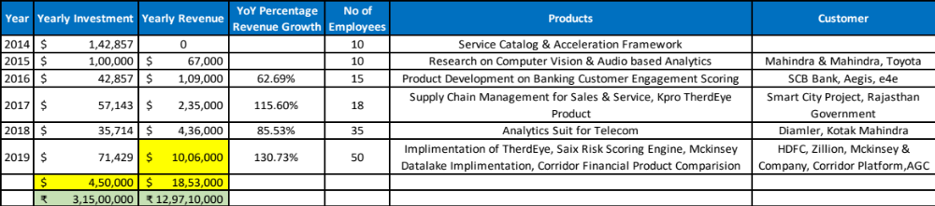
  Revenue Status

Slide 17
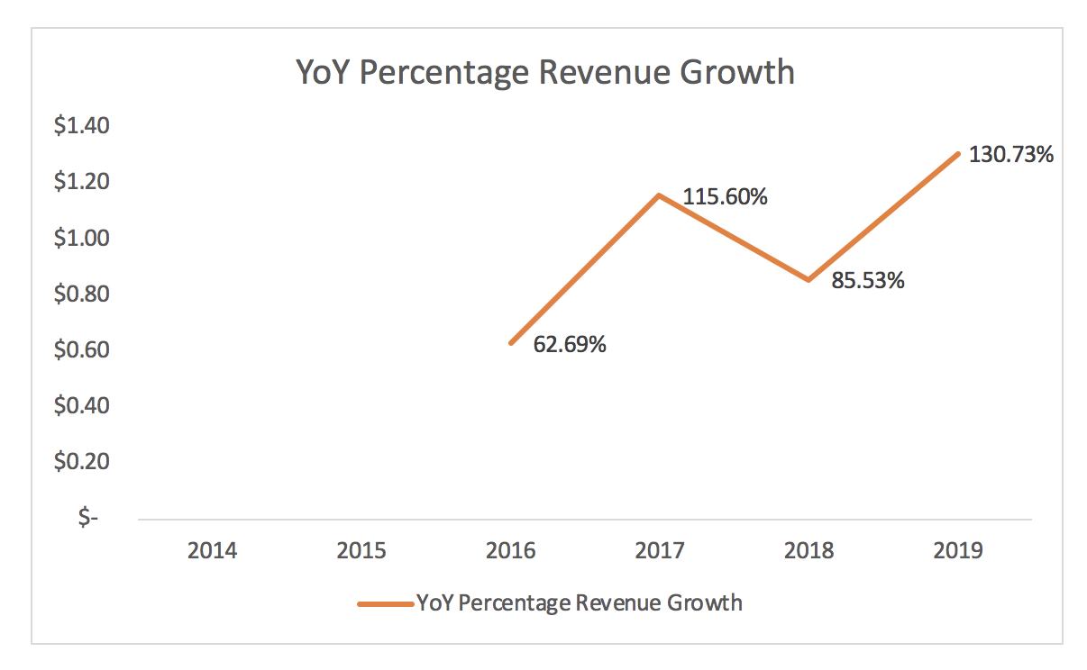
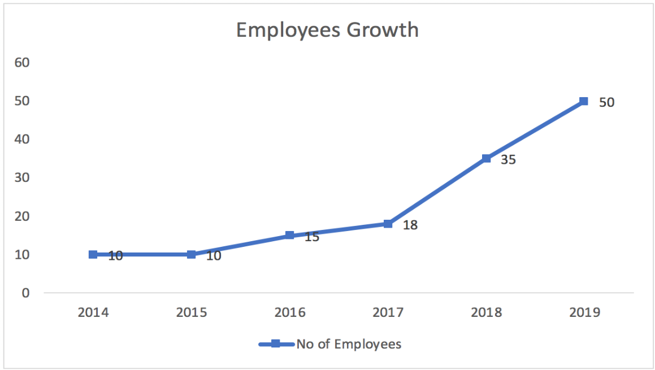
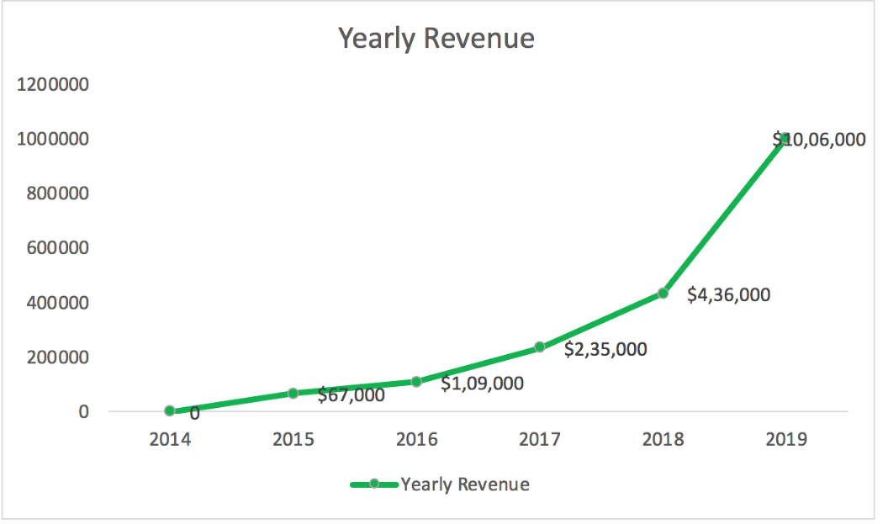
  Revenue Status (Cont..)

Slide 18
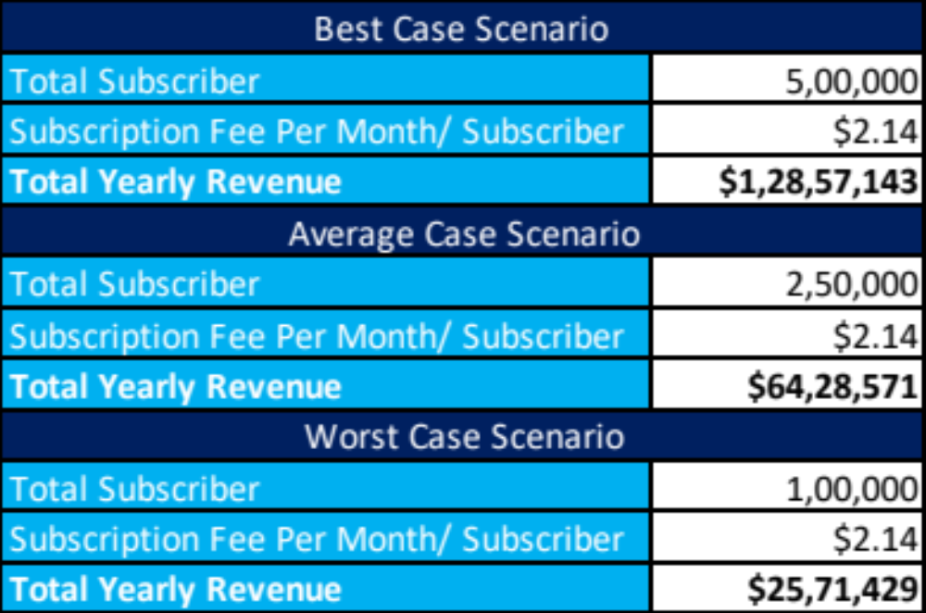
  Revenue & Expense Forecast from 1st to 3rd Year – TherdEye
19.5 Million Dollar
200 Employees
Conversion of Kpro TherdEye from B2B to B2C
Enabling Kpro TherdEye to other domains (Schools, Home Security and Small Stores)
Derive active subscription of TherdEye to 500K Subscriber with revenue of 12.8 Million Dollar for best case scenario
Revenue from other product and services
This estimate is only for Indian market, in case of international market, revenue will exponentially increase
Breakeven will be achieved in 4th Year.
Second round of investment will be required in 2nd Year
Third round of investment will be required in 3rd Year with valuation of more than 200 Million Dollar
Expense will be 25 Million Dollar

Slide 19
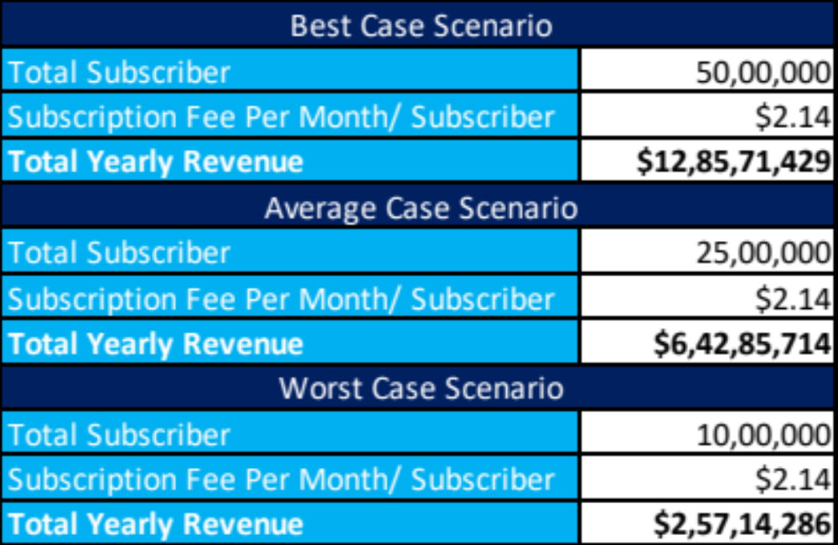
  Revenue & Expense Forecast from 4th to 5th Year – TherdEye,*
128.4 Million Dollar
300 Employees
Large Scale adoption of Kpro TherdEye
Increase Active Subscriber to 5 Million by reaching out restaurant chain, retail chain, offices etc.
Increase the adoption of other products in B2B market
Expense will be 93 Million Dollar
This estimate is only for Indian market, in case of international market, revenue will exponentially increase
The profit will be 35.4 Million Dollar, with evaluation 1.5 Billion Dollar

Slide 20
  High Level Plans for 1st to 3rd Year
Human Resource Expansion
Add more engineers, data scientists and architects
Add sales and marketing resources
Add feet on street
Add 24/7 customer support
Enhance the R&D Team
Customer Acquisition Plan
Digital Marketing (Social Media, Google Click.
Tie up with Camera Vendor Collaboration
Collaboration with school chains
Collaboration with open office provider
Collaboration with play school providers
Collaboration with transport providers
Collaboration with retail chains
Product Enhancement
Enhance Kpro TherdEye from B2B to B2C
Integrate voice analytics capability
Enhance mobile Interface
Enhance the service architecture
UK, US
Canada, South Africa
Geo
Footprint
India
2022
2024
2021
2023
2014-2020
Japan, Singapore
UAE

Slide 21
  Summary
Kpro is debt free company with operating profit, It has been growing with an average 100% YOY. Last year we have reported 450K USD of revenue.
It will reach revenue of more than 1 Million USD By end of financial year end 2019 .
The valuation of company will be more than 10 Million USD By financial year end 2019.
Product TherdEye will have deployment in one of the largest private bank in India.
We are looking to convert the TherdEye product from B2B to B2C model, which requires the investment of 4.5 Million USD.
Kpro will be making investment of 1.5 Million USD to enhance the TherdEye capability in year 2020. However we will be running sort of 3 Million USD to make it fully equipped solution with great customer experience, which we are looking to raise for 30% stake.
Kpro will continue to generate revenue from its service and consulting portfolio.

Slide 22
  Investment Required & Distribution
Investment Distribution
10%
Product Enhancement
25%
Required Investment
Operation
$3 Million
35%
Sales & Marketing
30%
Proposal: 30% Stake for 3 Million USD
Infrastructure

